Slide 1
CUSTOMER RELATIONSHIP MANAGEMENT
CONCEPTS AND TECHNOLOGIES
Chapter 7
Creating value for customers

Slide 2
Value definition
Value is the customer’s perception of the balance between benefits received from a product or service and the sacrifices made to experience those benefits.

Slide 3
Value equation
Value = Benefits
Sacrifices

Slide 4
Sacrifices
Money
Search costs
Psychic costs

Slide 5
Perceived risk
Perceived risk is an element of psychic cost.
Perceived risk takes a variety of forms – performance, physical, financial, social and psychological.

Slide 6
How do customers reduce perceived risk?
Delay purchase
Seek word-of-mouth endorsement
Negotiate service contracts
Seek additional information from advertising copy
Buy known brands
Deal with reputable suppliers
Seek performance guarantees
Buy with credit card (protection if product fails)
Negotiate discounts
Take out insurance
Demand pre-purchase trial

Slide 7
Total Cost of Ownership (TCO)
TCO looks not only at the costs of acquiring products, but also the full costs of using, and servicing the product throughout its life, and ultimately disposing of the product.
What is thought of as ‘consumption’ can be broken down into a number of activities or stages, including search, purchase, ownership, use, consumption and disposal.
TCO is an attempt to come up with meaningful estimates of lifetime costs across all these stages.

Slide 8
How companies compete - the 5C’s
Conflict
  Destroy the competition, e.g. BA v Laker Airways
Competition
  Perform better than competitors at meeting customer requirements, e.g. Procter & Gamble v Unilever
Co-existence
  Allow other companies to operate in their own niche, providing they don’t enter your market e.g. Cross® v Bic
Co-operation
  Formation of strategic alliances, e.g. IBM & Sun Microsystems
Collusion
  Conspire with competitors to restrain competitive behaviours, e.g. O.P.E.C.

Slide 9
Value proposition definition
A value proposition is the explicit or implicit promise made by a company to its customers that it will deliver a particular bundle of value-creating benefits.

Slide 10
Value delivery strategies
Operational excellence
Product leadership
Customer intimacy

Slide 11
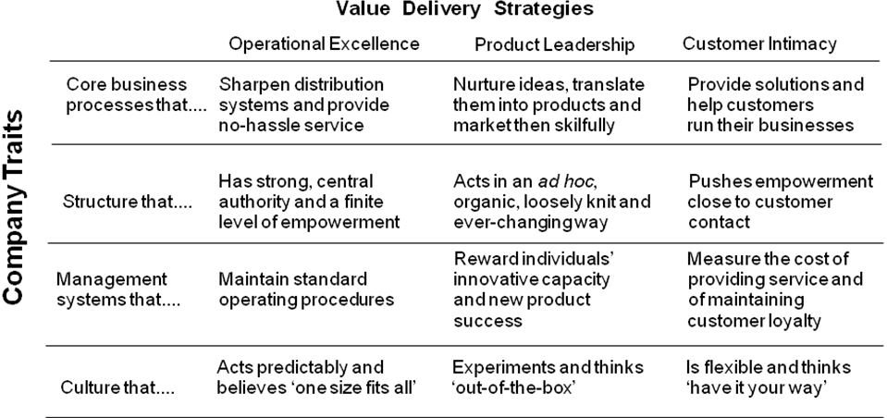
Three value disciplines

Slide 12
Sources of customer value in the marketing mix
Good marketing mix
  product
  price
  promotion
  place
Service marketing mix
  product
  price
  promotion
  place
  process
  participants
  physical evidence

Slide 13
Customisation
Customisation
  has both cost and revenue implications.
  may mean the loss of economies of scale thus increasing unit costs.
  means that companies have to be aware of and responsive to customers’ differing requirements.
  Configurator technologies assist in customising products
  has been the norm in B2B markets for many years.
  any of the 7Ps of the marketing mix can be customised

Slide 14
Customising the 7P’s 1
Product
  Solvay Interox, a chemicals company, customizes its hydrogen peroxide product for textile industry customers
Price
  Dell Computer offers lower prices to its larger relationship customers than its small office-home office (SOHO) customers
Promotion
  Ford customizes communications to its dealership network.
Place
  Procter and Gamble delivers direct to store for its major retail customers but not smaller independents.

Slide 15
Customising the 7P’s 2
Process
  Xerox customises its service guarantee and recovery processes for individual customers
People
  Hewlett Packard creates dedicated virtual project groups for its consultancy clients
Physical evidence
  Thomson and other major tour operators overprint their point-of-sale material with travel agency details

Slide 16
Mass customisation definition
Mass customisation is the use of flexible processes and organizational structures to create varied and even individually tailored value propositions, with neither a cost nor a lead-time penalty.

Slide 17
Types of mass customisation
Type of mass customisation | How it works | Example
Match–to-order or locate-to-order | Selection of existing standard products or services to match customer requirements | Cars
Bundle-to-order | Bundling of existing products and services to suit customer requirements | Conferences
Assemble-to-order | Assembly of products or services from existing standardised components or processes | Computers
Make-to-order | Manufacture of customised products including components | Tailored suits
Engineer-to-order | Customer co-designs products or services which are then made-to-order | Aircraft

Slide 18
Mass customisation questions for CRM strategists
Do customers want customised products and services?
What degree of customisation is desired?
Are customers willing to pay a premium for customisation?

Slide 19
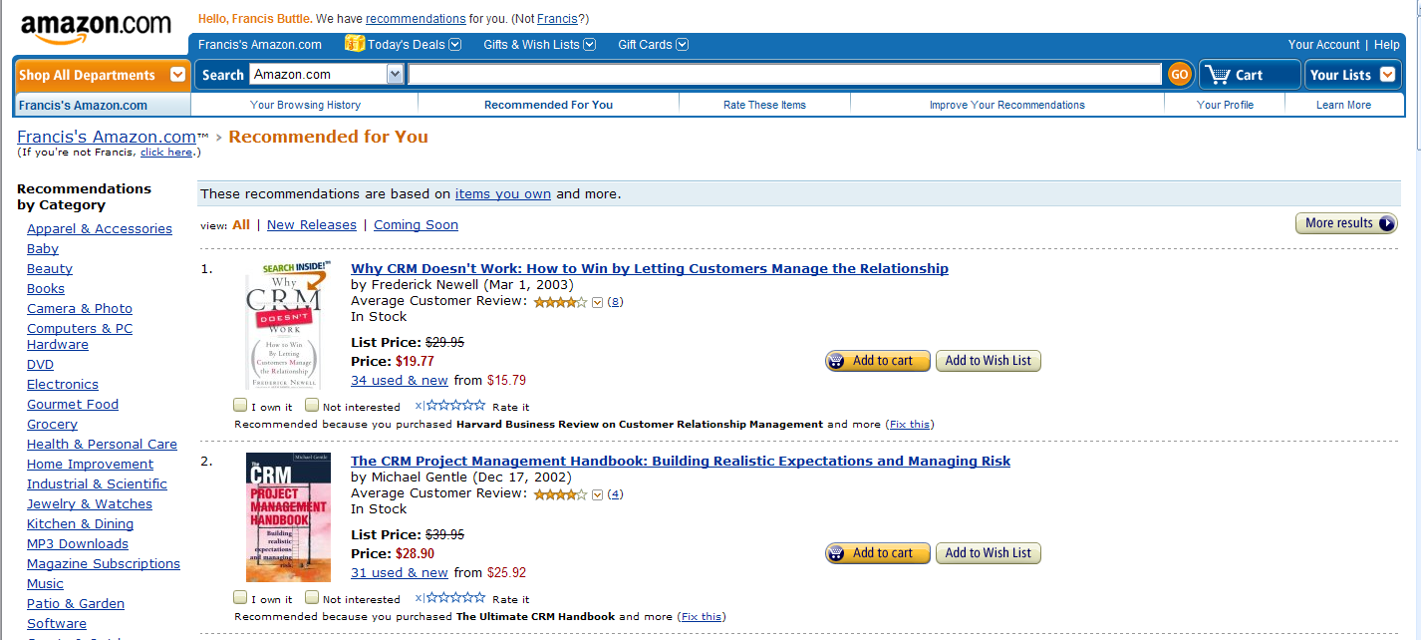
Customised webpage at Amazon.com

Slide 20
Value from products
product innovation
additional benefits
product-service bundling
branding
product synergies

Slide 21
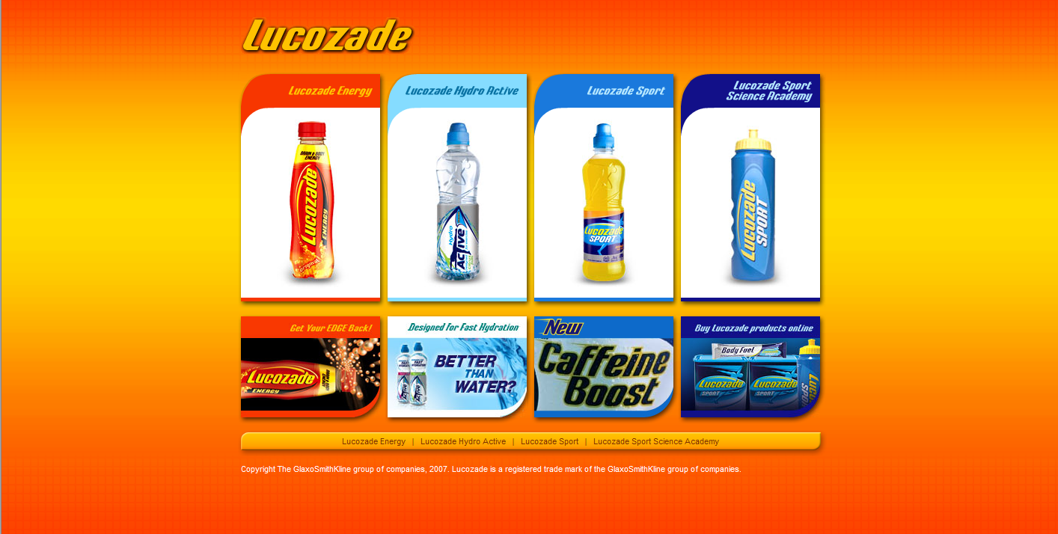
Repositioning Lucozade as a sports drink

Slide 22
Brand definition
A brand is any name, design, style, words or symbols that distinguish a product from its competitors

Slide 23
Two major perspectives on service quality
Conformance to specification.
  This is consistent with Philip Crosby’s view of quality. Conformance to specification might mean producing error-free invoices, delivering on-time, in-full as promised to customers, or acknowledging a customer complaint within 24 hours.
Fitness for purpose.
  Joseph M. Juran advanced the point of view that quality means creating products that are well suited to customer requirements, and which therefore meet their expectations. It is the customer, not the company, who decides whether quality is right.

Slide 24
Nordic model of service quality
Technical | The quality of the outcome of a service performance
Functional | The quality of the performance of a service
Reputational | The quality of the service organisation’s image

Slide 25
SERVQUAL model of service quality
Reliability | Ability to perform the promised service dependably and accurately
Assurance | Knowledge and courtesy of employees and their ability to convey trust and confidence
Tangibles | Appearance of physical facilities, equipment, personnel and communication materials
Empathy | Provision of caring, individualised attention to customers
Responsiveness | Willingness to help customers and to provide prompt service

Slide 26
SERVQUAL gaps model
Word of mouth
communications
Personal needs
Past experience
Expected service
Gap 5
Customer
Perceived service
Gap 1
Service delivery (incl.
pre- and post contacts)
External
communications
to consumers
Gap 4
Gap 3
Company
Translation of perceptions into
service quality specifications
Gap 2
Management perceptions
of customer expectations

Slide 27
SAS airline’s understanding of customers’ expectations
Tailoring of the service
Support my situation
Support the customer’s activity
Support what I need/want to do
Help me through the process
Get me there on time
Fundamental service performance
Get my stuff there as well
Get me there safely

Slide 28
Service guarantee definition
A service guarantee is an explicit promise to the customer that a prescribed level of service will be delivered

Slide 29

Sample service guarantee

Slide 30
Service level agreement definition
A service level agreement is a contractual commitment between a service provider and customer that specifies the mutual responsibilities of both parties with respect to the services that will be provided and the standards at which they will be performed.

Slide 31
A variety of SLA metrics
Availability
  The percentage of time that the service is available
Usage
  The number of service users that can be served simultaneously.
Reliability
  The percentage of time that the service is withdrawn or fails in the time period
Responsiveness
  The speed with which a demand for service is fulfilled.
User satisfaction.
  This can be measured at the time the service is delivered or periodically throughout the agreed service period.

Slide 32
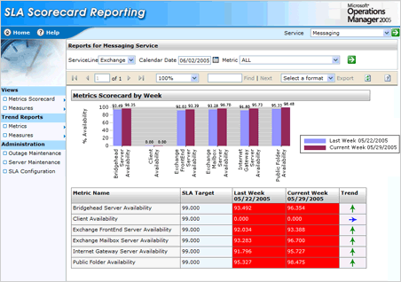
SLA scorecard

Slide 33
Service recovery definition
Service recovery includes all the actions taken by a company to resolve a service failure.

Slide 34
Service recovery and justice seeking
Distributive justice
  what the firm offers by way of recovery and whether this output offsets the costs incurred by the customer from service failure
  distributive outcomes include compensation, re-performance, apologies
Procedural justice
  customers’ perception of the process experienced to obtain recovery
  some procedures offer prompt recovery, others delayed; some require complaints to be legitimised
Interactional justice
  the customer’s perception of the performance of service recovery people
  empathy, politeness, courtesy, effort

Slide 35
Xerox’s 14 key business processes
Customer engagement
Inventory management and logistics
Product design and engineering
Product maintenance
Technology management
Production and operations management
Market management
Supplier management
Information management
Business management
Human resource management
Leased and capital asset management
Legal
Financial management

Slide 36
Complaints-handling process
A successful complaints handling process enables companies to capture customer complaints before customers start spreading negative word-of-mouth or take their business elsewhere.
Research suggests that negative word-of-mouth can be very influential. Up to two-thirds of customers who are dissatisfied do not complain to the organisation. They may, however, complain to their social networks.
Unhappy customers are likely to tell twice as many people about their experience than customers with a positive experience.

Slide 37
Why don’t unhappy customers complain?
They feel the company doesn’t care. Perhaps the company or the industry has a reputation for treating customers poorly
It takes too much time and effort
They fear retribution. Many people are reluctant to complain about the police, for example
They don’t know how to complain.

Slide 38
Complaint-handling tips
A well-designed complaints-handling process will capture complaints from various touch-points, then aggregate and analyse them to identify root causes.
This should enable the company to achieve a higher level of first-time reliability, reduce the amount of rework, and lift levels of customer satisfaction and retention.
An international standard – ISO 10002 – has been released to help companies identify and implement best practices in complaints policy and process.
Software is available to help companies improve their complaints-handling expertise

Slide 39
Improving the complaints management process 1
Make your complaints-handling policy and processes visible and accessible to customers and employees
Train employees how to respond to complaints
Ask for specifics. Not ‘what do you think about your experience?’. Instead ask, ‘what one thing could we have done better?’
Empower employees to resolve complaints
Install a dedicated free-phone line
Link complaints to your mission to become more customer-focussed

Slide 40
Improving the complaints management process 2
Designate a customer service executive to deal with written complaints
Enable customers to complain at all touch-points
Ensure all employees understand the complaints management process
Reward customers who complain
Collect complaints data and analyse root causes
Implement technology to support complaints-handling and generate useful management reports

Slide 41
Value from people at Nortel
“At Nortel we believe that our people are our strength. Their knowledge, commitment, and talents drive our success.”

Slide 42
Trends driving key account management
global customers
consolidated purchasing
vendor reduction programmes
customers want better service and closer relationships with their suppliers.

Slide 43
Physical evidence definition
Physical evidence consists of the tangible facilities, equipment and materials that companies use to communicate value to customers

Slide 44
Forms of physical evidence
company premises
internal and external environments
print materials
websites
corporate uniforms
vehicle livery

Slide 45
Web portal definition
A web portal is a website that serves as a gateway to a range of subject-related resources.

Slide 46
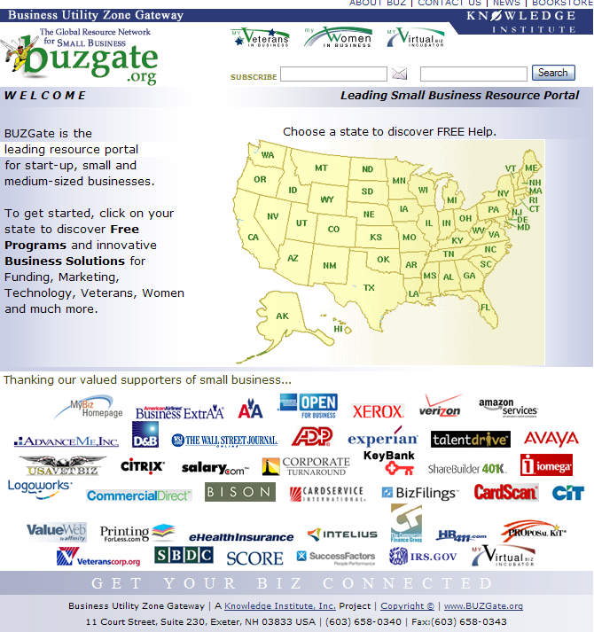
www.buzgate.org

Slide 47
Value from communication – 3 key processes
Disintermediation
Personalisation
Interactivity

Slide 48
Value from Internet-enabled disintermediation
Portal directories such as Yahoo! and Excite
Search engines such as Alta Vista and Infoseek
Electronic shopping malls such as www.eMall.sg and www.emallroad.com
Virtual resellers such as Amazon and CDNow

Slide 49
Strategic options for electronic channels
No Internet sales.
Internet sales by reseller only
Internet sales by producer only
Internet sales by all

